Slide 1
HTML5 Canvas API
A canvas is used to draw graphics inside a browser, using JS
Supports 2D and hardware-accelerated 3D via WebGL
Examples:
http://processingjs.org/
http://fabricjs.com/
https://playcanvas.com/play
Before HTML5, Flash was used for web graphics

Slide 2
HTML5 Canvas API (2)
Defined in HTML via the <canvas> tag:
Controlled with JavaScript via its context object:
Size of the canvas,
defined in pixels
Used by JavaScript for identification
<canvas width="800" height="600" id="canvas"></canvas>
let canvas = document.getElementById("canvas");
let ctx = canvas.getContext("2d“);

Slide 3
Drawing Shapes
The API offers built-in functions for drawing simple shapes
Simplest shape is a rectangle
Drawing parameters (color, linewidth) can be customized
Top-left corner
Dimensions
ctx.fillRect(x, y, width, height)

Slide 4
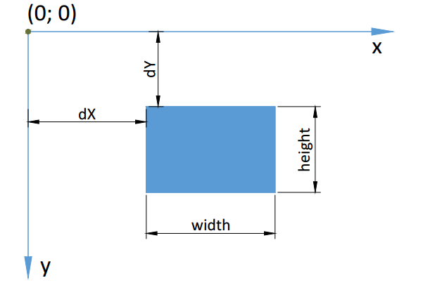
Canvas Coordinates
Coordinates (0; 0) at top-left

Slide 5
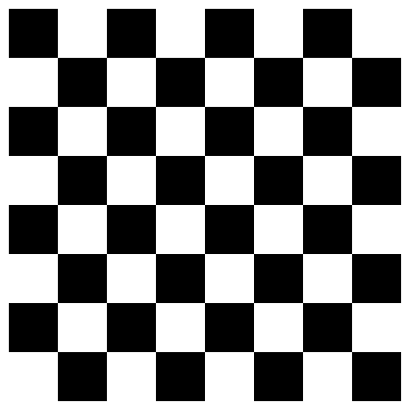
Example: Draw Checkerboard
for (let row = 0; row < 8; row++) {
for (let col = 0; col < 8; col++) {
if ((row + col) % 2 == 0) {
let x = 25 + col * 50;
let y = 25 + row * 50;
ctx.fillRect(x, y, 50, 50);
}
}
}

Slide 6
Drawing Shapes (2)
Lines and paths can be drawn with similar commands
ctx.beginPath(); // Start new shape
ctx.moveTo(x, y); // Move cursor
ctx.lineTo(x, y); // Draw line
ctx.closePath(); // Draw line to start
ctx.stroke(); // Apply outline
ctx.fill(); // Fill shape

Slide 7
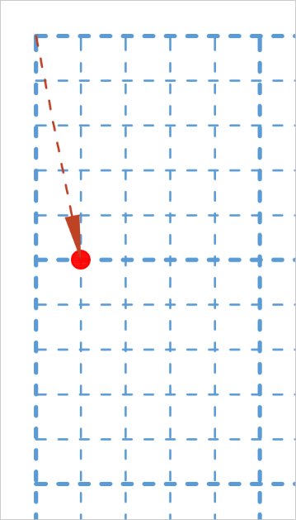
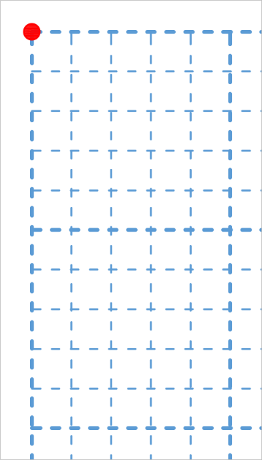
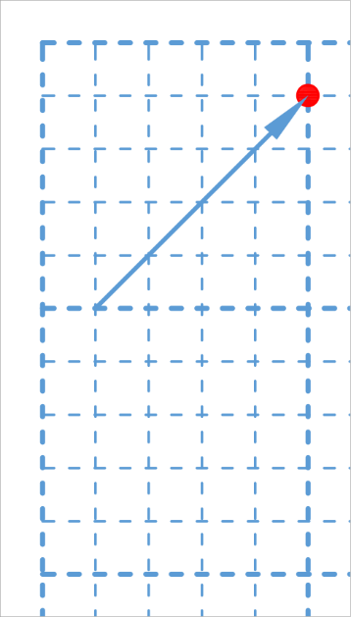
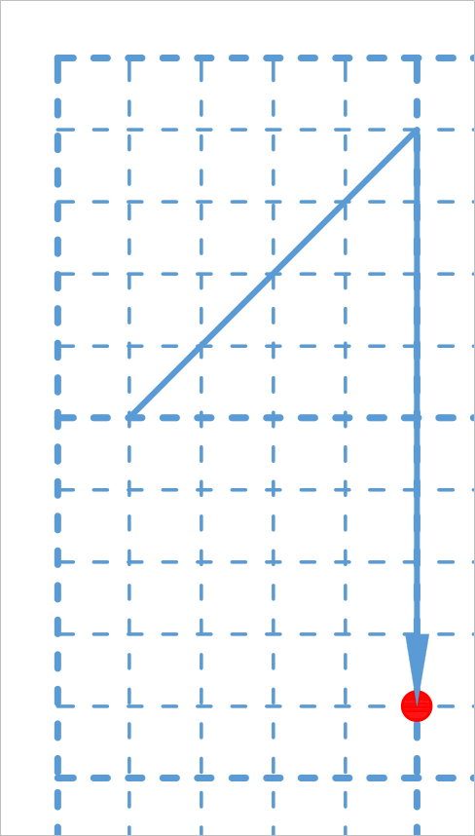
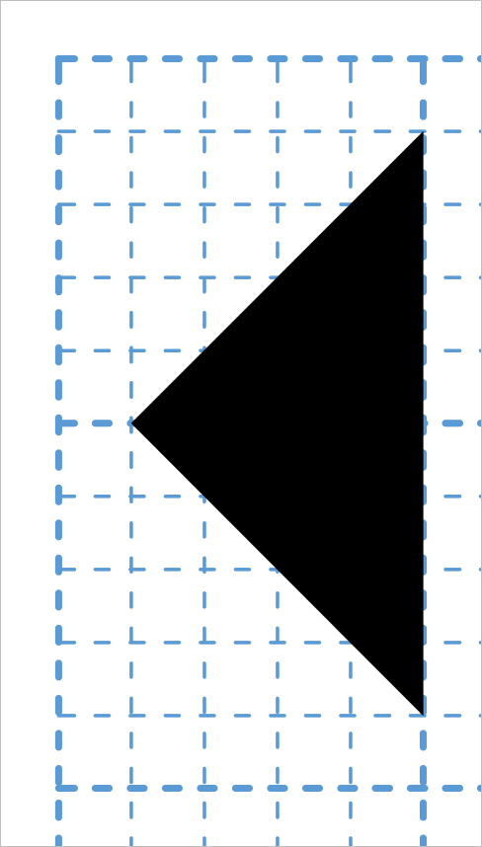
Example: Draw Figure
Draw triangle
ctx.beginPath();
ctx.moveTo(10,50);
ctx.lineTo(50,10);
ctx.lineTo(50,90);
ctx.fill();

Slide 8
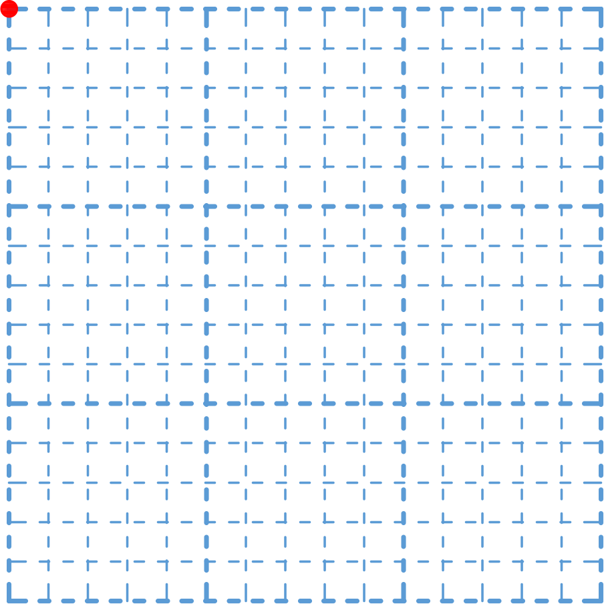
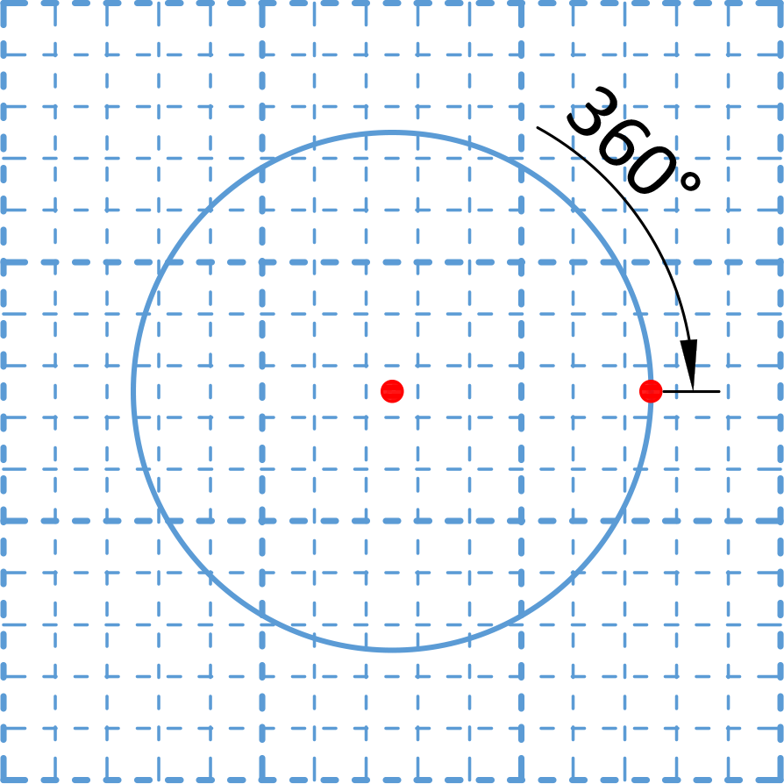
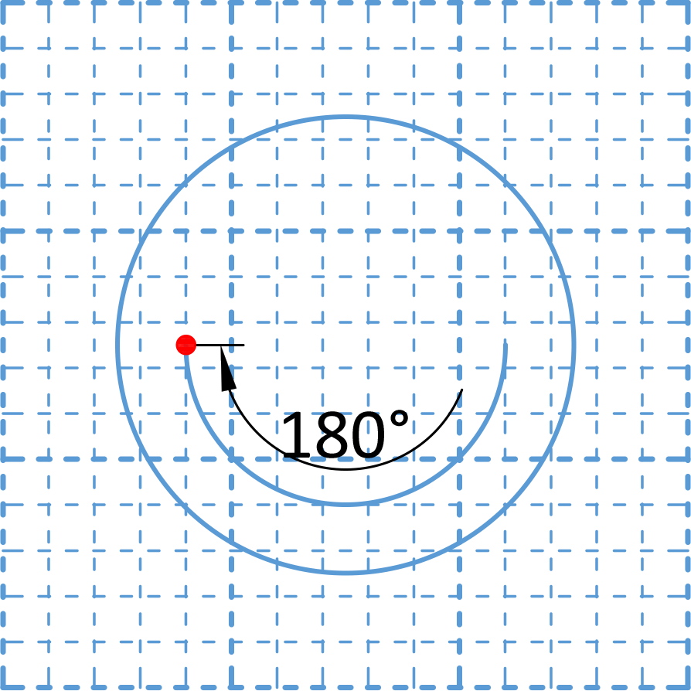
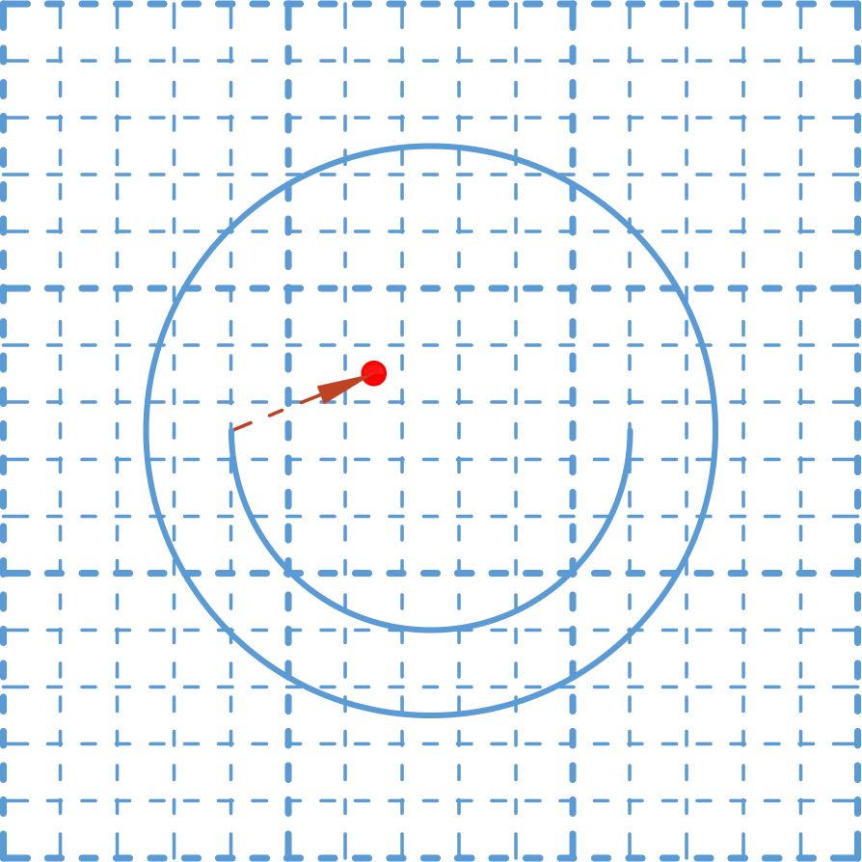
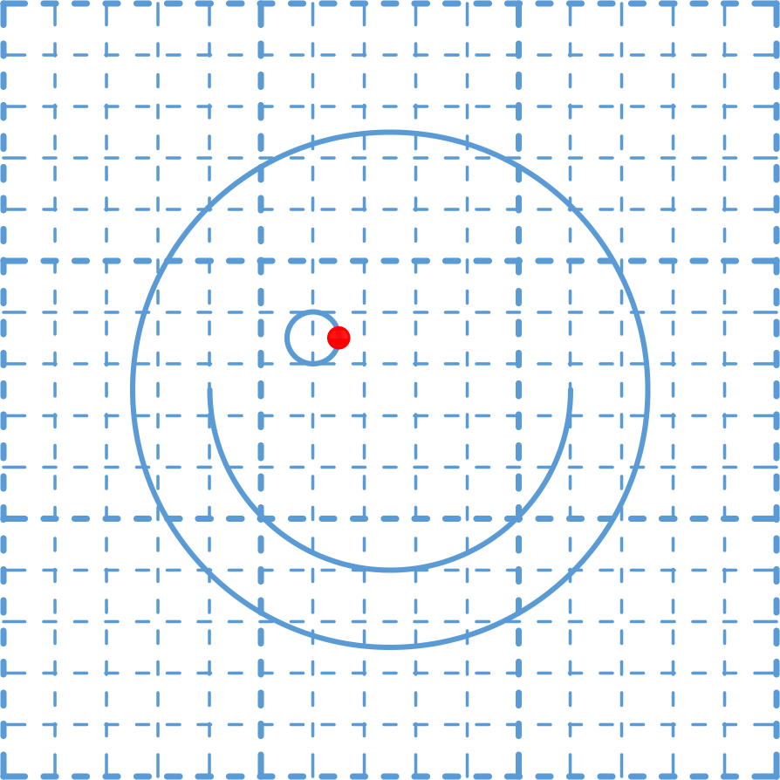
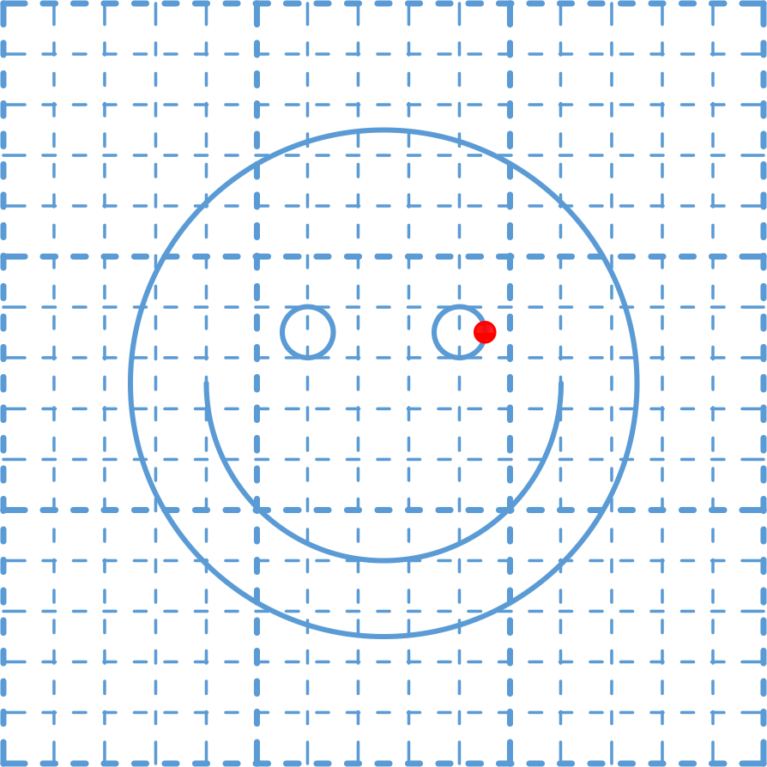
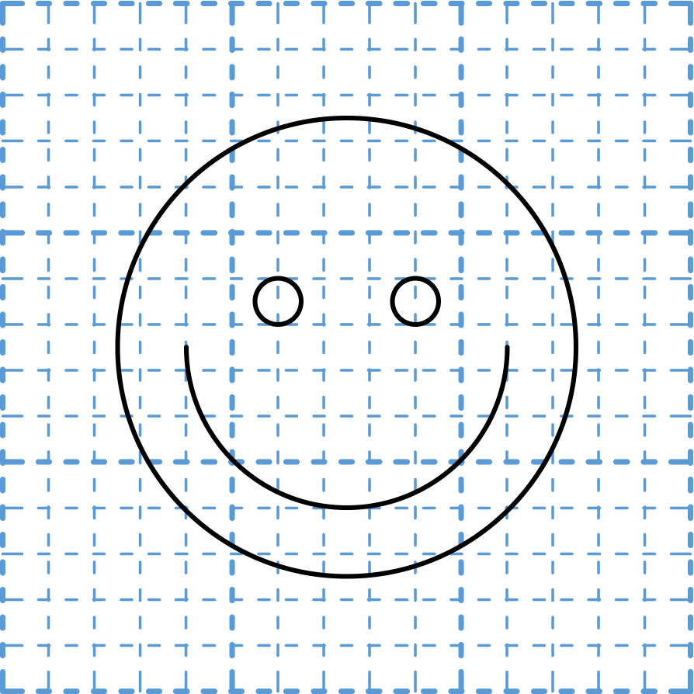
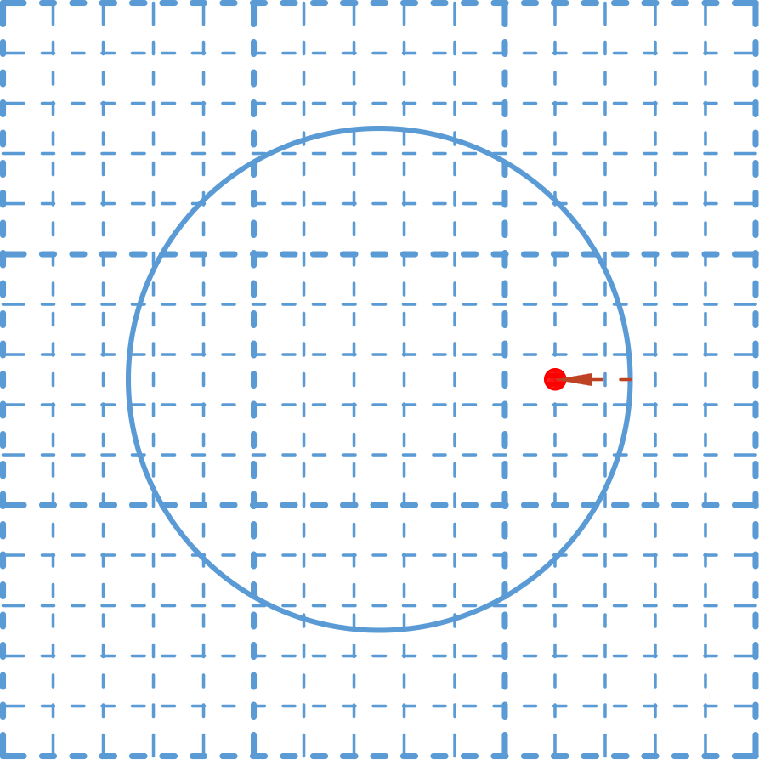
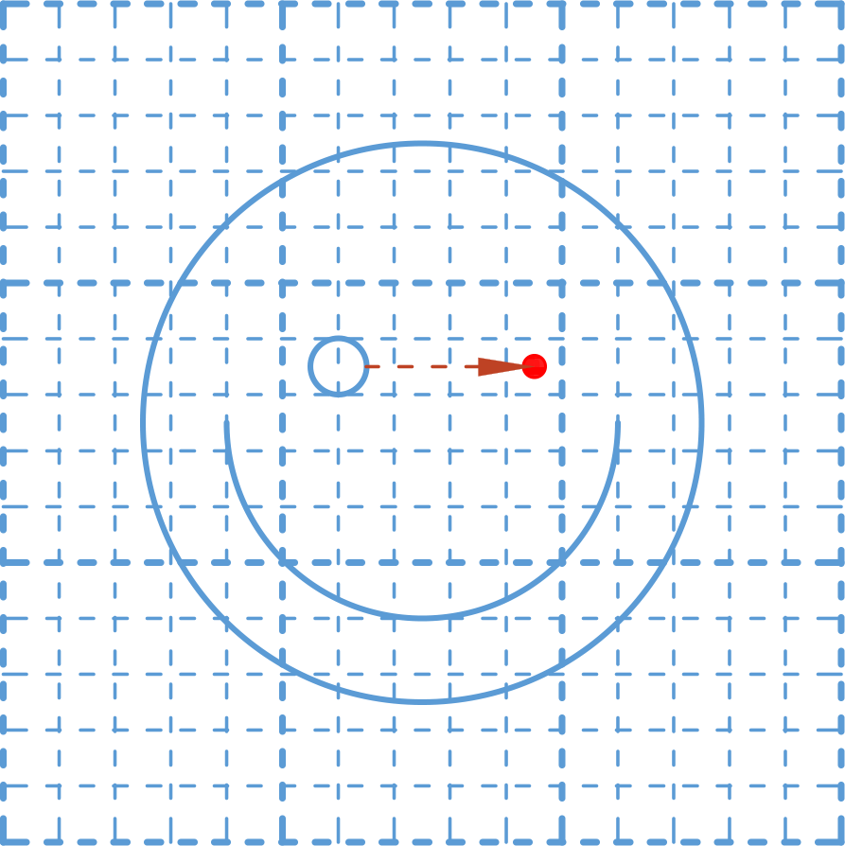
Example: Draw Figure (2)
Draw smiley face
ctx.beginPath();
ctx.arc(75,75,50,0,Math.PI*2,true);
ctx.moveTo(110,75);
ctx.arc(75,75,35,0,Math.PI,false);
ctx.moveTo(65,65);
ctx.arc(60,65,5,0,Math.PI*2,true);
ctx.moveTo(95,65);
ctx.arc(90,65,5,0,Math.PI*2,true);
ctx.stroke();

Slide 9
Using Colors And Patterns
The color and pattern of default shapes can be customized
Shape fill can be changed using ctx.fillStyle
Line color can be changed using ctx.strokeStyle
Valid formats are
Color string literals: 'black', 'red', 'orange', etc.
CSS Color: '#FFA500'
RGBA combination: 'rgba(255, 165, 0, 1)'

Slide 10
Line Styles
Line strokes can be further customized
lineWidth – changes width of line
lineCap – changes style of line ends
lineJoin – changes appearance of corners
setLineDash(segments) – changes the dash pattern
Dash patterns are defined as an array of lengths for alternating solid and gap segments

Slide 11
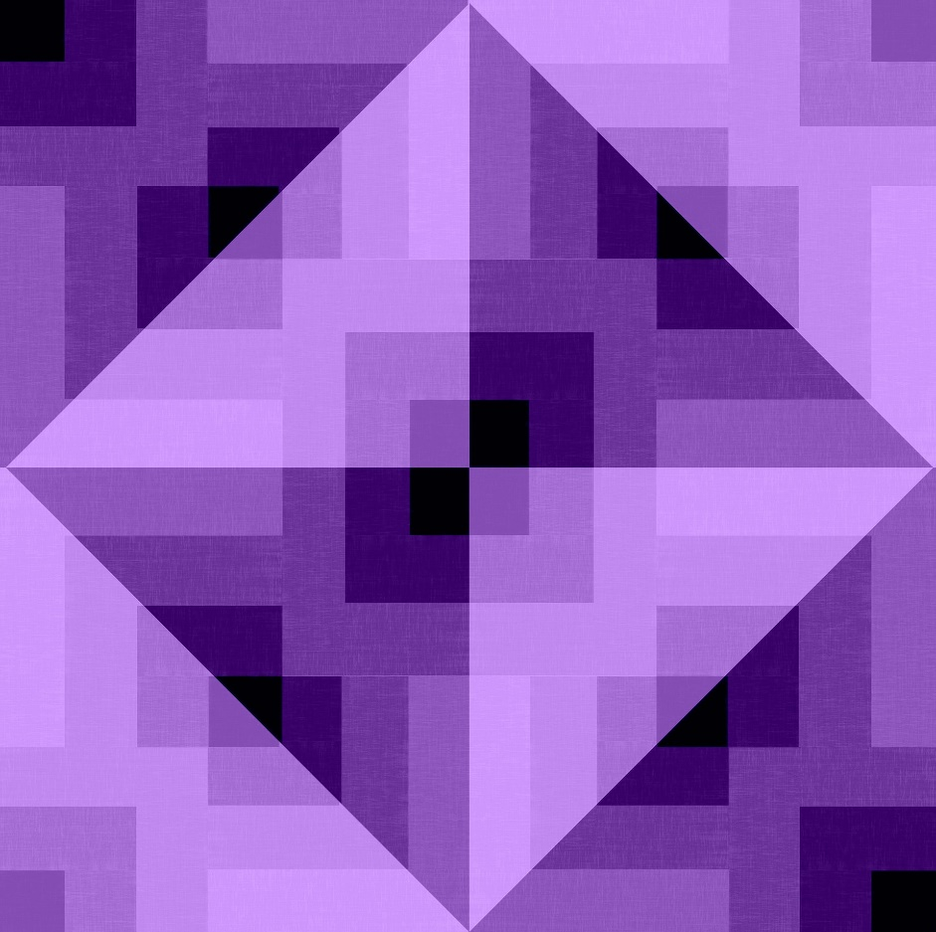
Live Demo
Shapes and Styles

Slide 12
Images
You can draw images on the canvas
Not all parameters are needed
Image resource
Source coordinates
ctx.drawImage(image,
sx, sy, sWidth, sHeight,
dx, dy, dWidth, dHeight);
Target coordinates
Draws whole image using original dimensions
ctx.drawImage(image, dx, dy);

Slide 13
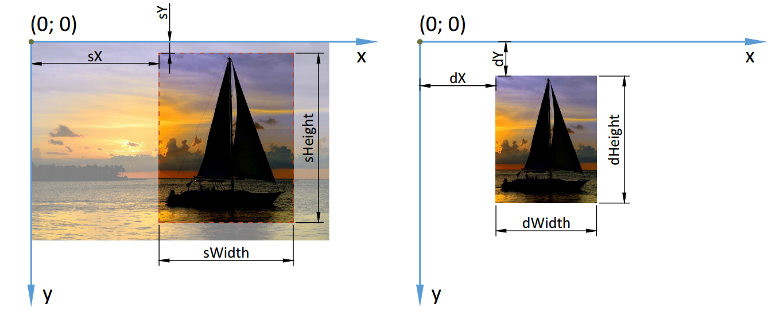
Images (2)
Source coordinates
Cropping an image
Destination coordinates

Slide 14
Drawing Text
Text can be outlined or filled, similar to other shapes
And customized:
ctx.font – changes the font type and size
ctx.textAlign – changes text alignment
ctx.fillText(text, x, y);
ctx.strokeText(text, x, y);

Slide 15
Example: Draw Button
Draw a button with a label
Draw button base
ctx.fillStyle = 'orange';
ctx.fillRect(30, 30, 200, 40);
ctx.fillStyle = 'white';
ctx.font = "24px monospace";
ctx.textAlign = 'center';
ctx.textBaseline = 'middle';
ctx.fillText("Submit", 130, 50);

Slide 16
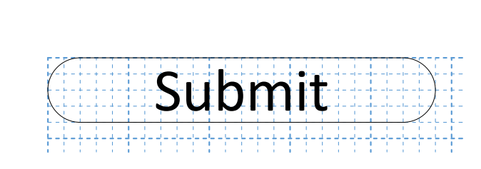
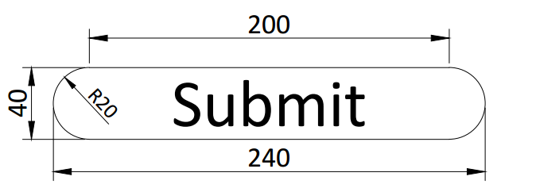
Problem: Rounded Button
Draw a button with a label and rounded edges

Slide 17
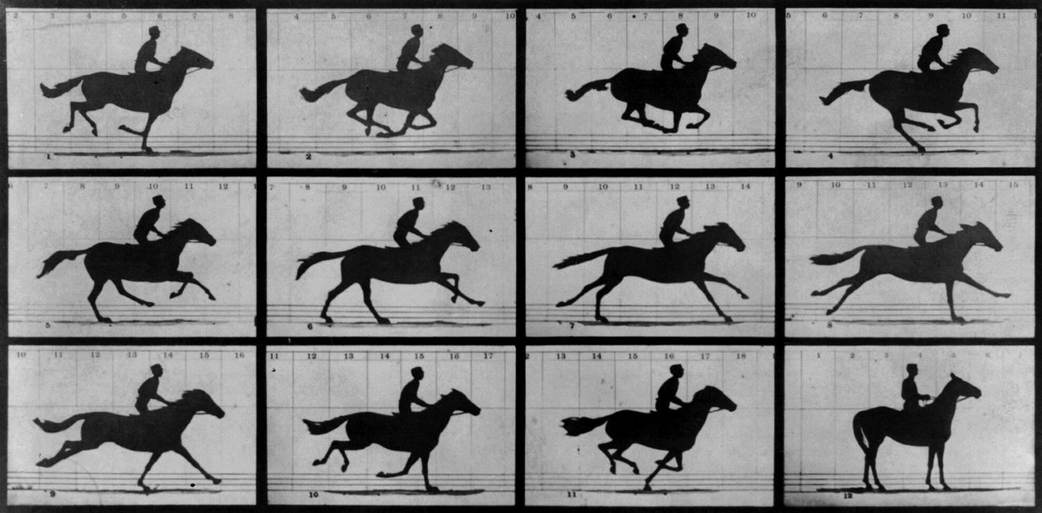
Animation with Canvas 2D
Creating Simple Animations

Slide 18
Animation Basics
Animation is achieved by gradually changing the contents of the canvas to smoothly morph it from one state to another
Most often, by changing the objects’ position
10
20
30
40
50

Slide 19
Animation Basics (2)
Timing (automatic redraw) is handled by the browser
setInterval(func, t) – execute every t milliseconds
requestAnimationFrame(func) – execute before the next frame draw
Example: loading bar

Slide 20
Animation Basics (3)
Clearing the canvas removes the previous frame
This allows movement to be simulated
We can clear the entire canvas or just parts of it
Example: Bouncing ball
ctx.clearRect(x, y, width, height);

Slide 21
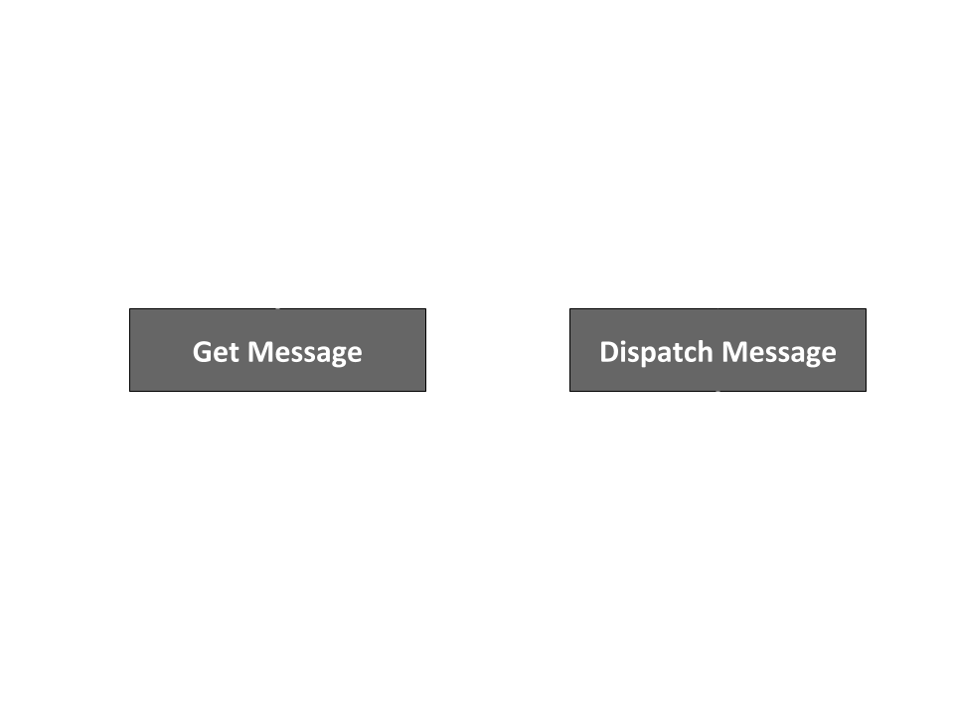
Handling Events
User Interaction with Keyboard / Mouse

Slide 22
Browser Events
Events are signals, sent from various sources
Buttons, keyboard presses, mouse movement/clicks
The browser can “listen” for events
A listener can be attached to any HTML object
The specified function is executed whenever an event of the correct type is registered
target.addEventListener(type, func);

Slide 23
Example: Animate on Button Press
HTML
JavaScript
<button type="button" id="drawBtn">Draw</button>
let btn = document.getElementById('drawBtn');
btn.addEventListener('click', animate);
function animate() {…}

Slide 24
Event Handler
The event handler function can take one parameter
The parameter holds information about the event
Useful when working with keyboard and mouse events
function handler(event) {
// Do stuff
}

Slide 25
Keyboard Events
keydown, keypress, keyup – detect keyboard event
event.code – string representation the key
Example: Move object with keyboard
function handler(event) {
if (event.code == "ArrowLeft") { position.x--; }
else if (event.code == "ArrowRight") { position.x++; }
}

Slide 26
Mouse Events
click, mousemove – detect mouse events
event.button – button pressed
event.clientX, event.clientY – coordinates
Example: Shoot ball towards mouse location
function handler(event) {
ball.x = 0; // Move ball to left edge
ball.y = event.clientY;
animate(); // Start animation
}

Slide 27
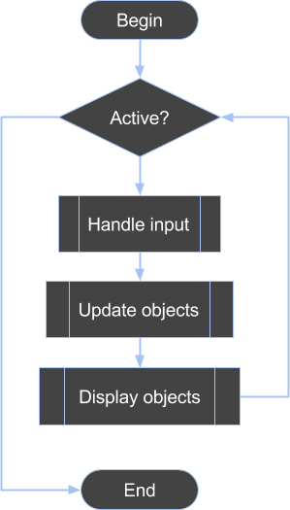
Game Loop
Tie It All Together

Slide 28
The Main Game Loop
Initialize
Check game state
Record button presses, mouse state
Process movement, physics, AI, etc.
Render
Cleanup

Slide 29
Sample Implementation
Define loop
function main() {
update();
render();
requestAnimationFrame(main);
}
function update() {…}
function render() {…}
requestAnimationFrame(main);
Main procedures
Start loop

Slide 30
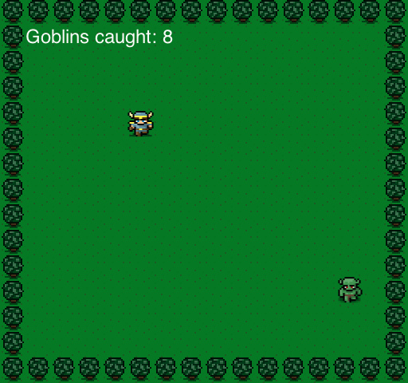
Live Demo
Creating a Game with Canvas 2D

